Slide 1
Social Media & Crisis Communication 2025
Liberty County Chamber/CVB

Slide 2
Housekeeping
  Bathrooms are in this room
  Turn your phone on silent or vibrate please
  Take calls outside
  Things to Know
If you’re joining this workshop, come ready for real, constructive feedback.
Our sessions are designed to help you grow, and that sometimes means hearing honest input about what can be improved — always with respect and the goal of making you better.
I’m also happy to meet one-on-one (in person, by email or text) with Chamber members to review your marketing. These sessions are just as honest and straightforward — no sugarcoating, but always supportive.
If you’re open to learning and ready for real improvement, you’ll get a lot out of it!

Slide 3
Learning Objectives
Define a clear social media strategy that aligns with your organization’s goals and audience.
Identify your target audience and choose the right platforms to reach them effectively.
Develop content pillars that reflect your brand’s values and resonate with your community.
Create engaging, authentic content that balances creativity with professionalism.
Use analytics and insights to measure success and adjust your strategy for better results.
Apply best practices in social media etiquette, consistency and brand voice.
Stay ahead of emerging including SEO, short-form video and micro-influencer marketing.

Slide 4
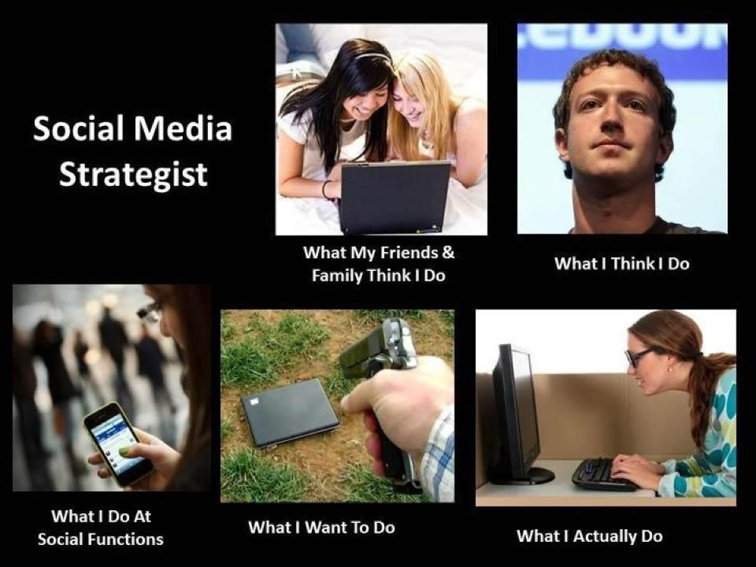

Slide 5
If you don’t have a defined goal & strategy for your marketing you are doing it wrong.
Goal: What do you want your marketing to get for you? More paying customers? More butts in seats? More people in the door? More website views? Write down your goal.
Strategy: What is your strategy for marketing? Is Facebook your only platform/effort? How often do you post? Do you have an email list? Is your strategy to reach your goal? If not START OVER.
Is your strategy 1. effective 2. defined 3. attainable
If not it’s time to redefine that strategy & stick to it!

Slide 6
Having SMART Goals
Specific Measurable Attainable Relevant
Time-bound

Slide 7
Goal-to-Platform Matrix
Marketing Goal | Best Platforms | Why These Platforms Work
Brand Awareness | Instagram, TikTok, Facebook | Visual storytelling, high reach, and shareable short-form content.
Lead Generation / B2B Growth | LinkedIn, Facebook | Professional audience targeting, lead forms, and business credibility.
Website Traffic | Facebook, Pinterest, LinkedIn | Strong link-sharing capability and referral traffic tools.
Event Promotion | Facebook, Instagram, Eventbrite | Easy event creation, RSVPs, and strong local reach.
Community Engagement | Facebook Groups, Instagram Stories | Great for two-way conversations and interactive content (polls, Q&As).
Recruitment / Hiring | LinkedIn, Facebook | Job posting tools and community-driven recommendations.
Customer Support / Updates | X (Twitter), Facebook | Fast communication and transparency for public updates.
SEO & Discoverability | YouTube, TikTok, Instagram | Searchable content with keywords, hashtags, and video SEO value.
E-commerce / Sales | Instagram, TikTok Shop, Facebook Shops | In-app shopping, influencer marketing, and impulse-buy potential.

Slide 8
💡 Tips:
Focus on 1–2 primary platforms that best align with your top goals.
Use cross-promotion (e.g., share event recaps on Instagram after promoting them on Facebook).
Review analytics quarterly to ensure each platform still meets its purpose.

Slide 9
What is a creative strategy?
A creative strategy is an intentional and strategic approach that we take in developing & implementing steps that will ensure and support our long-term growth. Our creative strategy serves as a call to action and provides the guiding principles for developing content. Using this strategy we can solve problems, as well as spark ideas that lead to our collective success. We will use data to assess and improve progress. We should be answering the questions: Are we doing the right things? AND Are we doing those things right?

Slide 10
What is our creative strategy?
  We want to create a relationship with people that will allow them to see us as the resource for accurate and timely information about our community.
  We want to push as many people as possible to our website because then we can begin converting them into paying customers (i.e. Chamber members or visitors).

Slide 11
Do you have content pillars?
It sounds silly. But pillars are important. Whether you’ve been in business/marketing for years or days, you need to know what makes your customers tick, what your brand is and stick with that.

Slide 12
Our Pillars
1. African American Heritage
Purpose: Celebrate culture, highlight local history, and amplify voices.
2. People
Purpose: Build connection through storytelling and community recognition.
3. Events
Purpose: Promote happenings that drive tourism, attendance, and engagement.
4. History
Purpose: Educate and inspire curiosity about Liberty County’s past.
5. Nature & Outdoors
Purpose: Showcase Liberty County’s scenic beauty and outdoor recreation.
6. Shopping & Dining Opportunities
Purpose: Support local businesses and attract visitors.
Bonus Tips
Rotate through these pillars weekly or biweekly to keep content balanced.
Use consistent visuals (color palette, hashtags, tone).
Repurpose — e.g., turn a Facebook photo post into a Reel or Story for extra reach.
End each caption with a call-to-action (“Plan your visit,” “Tag a friend,” “Join today”).

Slide 13
Authenticity Over Perfection
What’s Changing
The era of heavily curated, over-edited posts is fading.
Audiences now crave authenticity, relatability, and transparency. They want to see the real people behind your brand — not just polished graphics and staged photos.
successful social media content feels human, not corporate.
Think less “perfect ad,” and more “authentic conversation.”
What Authentic Content Looks Like
Unfiltered Stories – Snap a quick photo or video from your phone showing “real life” moments: staff at work, event prep, community interactions.
Behind-the-Scenes Videos – Let followers see the process — not just the finished product. (e.g., setting up for an event, making a dish, packaging an order.)
Casual, Off-the-Cuff Reels – Use trending audio, but make it natural. Talk to the camera like you’re chatting with a friend.
User-Generated Content (UGC) – Share photos, reviews, or videos made by your customers or visitors (with permission). It builds trust and community.
Candid Photos Over Stock Images – Real smiles, real people, real places. Imperfections make it believable — and more clickable.

Slide 14
Why It Works
Builds trust and relatability — followers feel connected to your mission.
Encourages higher engagement — authentic content often outperforms designed posts.
Shows personality and heart — especially valuable for small businesses and community organizations.
Saves time and money — quick videos or behind-the-scenes clips require less production.

Slide 15
Finding the Right Content Balance
The 40/40/20 Content Mix Rule
Type of Content | % of Posts | Purpose | Examples
🧠 Educational / Informative | 40% | Provide value, position your brand as a trusted expert. | - “How to” tips, FAQs, tutorials - Local insights or resources - Explaining industry trends or data
💬 Engaging / Community-Building | 40% | Spark conversation and build relationships. | - Polls, Q&As, stories, user features - Contests, photo challenges, or shoutouts - Behind-the-scenes or team highlights
💼 Promotional / Sales | 20% | Drive conversions and awareness of your offerings. | - Product or event launches - Special offers or memberships - Testimonials or success stories

Slide 16
Why It Works
Keeps your feed balanced and audience-centered rather than sales-heavy.
Encourages followers to engage organically, not just scroll past ads.
Builds trust and brand loyalty — when 80% of your content gives value, the 20% that sells actually works better.
Pro Tip
If you’re just starting out, try tracking your last 20 posts — categorize each into educational, engaging, or promotional, and adjust to hit the ideal mix over time.

Slide 17

Use your analytics!
Analytics never lie. This is the easiest way to see what works and what doesn’t!
Tracking keywords and trending topics on your social media channels will help you stay ahead of the curve.
Instagram, Meta, TikTok and YouTube business accounts all have their analytics built in – use these! Do you know where to find them?
They help you monitor the latest trends to better understand how to target your audience.

Slide 18

Set goals
Have a goal set for each platform.
  That could be for 3 months, 6 months, a year. Make it something challenging but realistic.
  That could be click throughs, engagement, new email subscribers, new followers, etc.
If you don’t meet those goals it’s time to adjust your strategy and/or consider ditching the platform.

Slide 19
Reach your goals
  Clarify your story
    Human brains care about their own story, not yours. So, make your message about something that helps them survive & make it simple and clear to understand. The enemy of business is noise.
    With your business, you should identify what your customer wants, define their challenges, and offer a tool to overcome those challenges and get what they want.
  Navigate seasons & set expectations.
-totally stolen from Jay Owen
And here’s another great article on this topic.

Slide 20
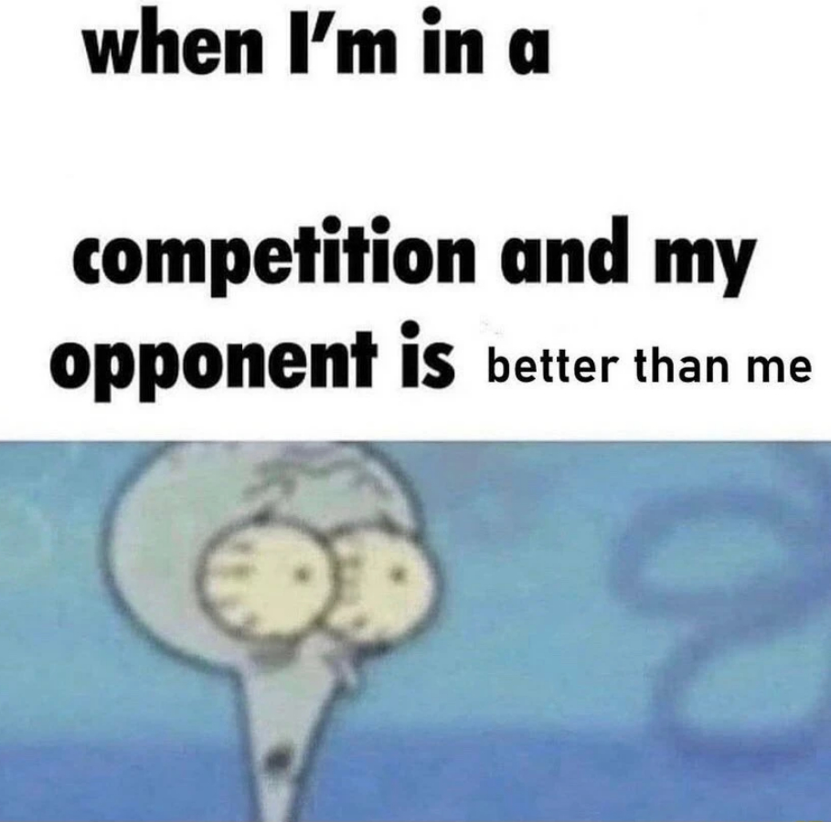
Keep a close eye on your competition.
Knowing what your competition is doing on their social media platforms is a great way to ensure that you're one step ahead.
Get new content ideas from them! Especially if you’re still growing.

Slide 21
Stay up to date!
With trends changing rapidly you'll want to make sure that you can switch up your social media strategy when you need!
Sign up for emails from research organizations:
Social Media Today and Marketing Dive
These are great ways to get a quick rundown without spending a ton of time. It’s their job to do this research & keep us up to date.

Slide 22
Hashtags and Emojis
DON’T overuse them.
You don’t want the overuse to scare people away.
They’re for your benefit.
They don’t work if you’re not using them correctly. What does this mean??
Users click on a hashtag to explore similar posts, so you want to be specific with your choices.
Do you know how to find emojis on a keyboard or just on your phone? Pro Tip: Windows Key & Period pulls up your menu!

Slide 23
Build Relationships — Don’t Just Post
Social media isn’t a bulletin board — it’s a conversation.
The strongest brands don’t just post content — they build connections with their audience.
Ways to Engage Authentically
  Polls & Q&As: Use Stories or posts to ask for opinions (“What’s your favorite local spot?”). People love to share their input.
  User-Generated Content (UGC): Encourage followers to tag your page or use a branded hashtag for a chance to be featured.
  Behind-the-Scenes Moments: Show the people and process behind your brand — authenticity builds loyalty.
  Celebrate Your Followers: Share milestones (“We hit 5,000 followers — thank you!”) or highlight community members.
  Reply & React: Engagement doubles when followers feel heard. Respond to every comment you can.
💡 Tip: Treat every interaction as if you were talking to a customer face-to-face — friendly, personal, and professional.

Slide 24
⏱️ Response Time Goals
Set clear standards for engagement — it shows followers you care.
Why it matters:
Quick replies build trust, encourage more comments, and tell your audience you’re active and attentive.
If you’re short on time, use saved replies or templates for common questions to stay consistent.
Platform | Recommended Response Time
Facebook & Instagram | Within 24 hours (ideally within 4–6 hours during business hours)
LinkedIn | Within 1 business day
TikTok / Threads | Within 12 hours for trending or fast-moving content

Slide 25
Handling Negative Comments
Do’s
Acknowledge quickly and calmly. Thank the person for the feedback.
Move the conversation private if it’s sensitive (“We’d love to chat more — please DM us!”).
Stay professional. Never argue, even if they’re wrong.
Monitor patterns. If multiple people mention the same issue, it’s worth addressing publicly.
Don’ts
❌ Don’t delete or hide legitimate criticism (especially for public or government entities).
❌ Don’t get defensive or sarcastic — it always backfires.
❌ Don’t ignore it — silence can seem like guilt or indifference.
Pro Tip: When handled well, a negative comment can become a powerful example of great customer service.

Slide 26
Sharing Posts
DON’T share others posts.
You want to create your own version of the post and tag the original user (if needed).
Sharing other’s post does nothing for you. Making your own version does.
Sharing content is often seen as an endorsement of that content and of the person who posted it. Why is this important??
Be careful what you share — it could become part of your brand.

Slide 27
Only post GOOD, QUALITY PHOTOS!
If your photo is bad, people will not even read your post.
You want to be sure to choose photos that will draw an audience.
Photos that convey feelings.
Photo credit is SO important.
Always give credit where it’s due. If you use someone else’s photo – give them credit. This also encourages them to do it in the future.

Slide 28
Post Length
Short, sweet & to the point.
This is always the best route to take. Some posts do need more words/explanation, so try to cut out the extra & make it as short as possible.
Using your accolades at the bottom of each post is really not necessary & not something that people are going to read. Most users will only read what is in the immediate window, they’re not clicking “read more.” This would be more appropriate at the bottom of a press release.

Slide 29
Fact Checking
DON’T: Share without researching first.
Be sure to always fact check your information before posting.
Always check the source of the information to confirm it’s credible.
If you post a fact that could be misconstrued – offer an explanation.

Slide 30
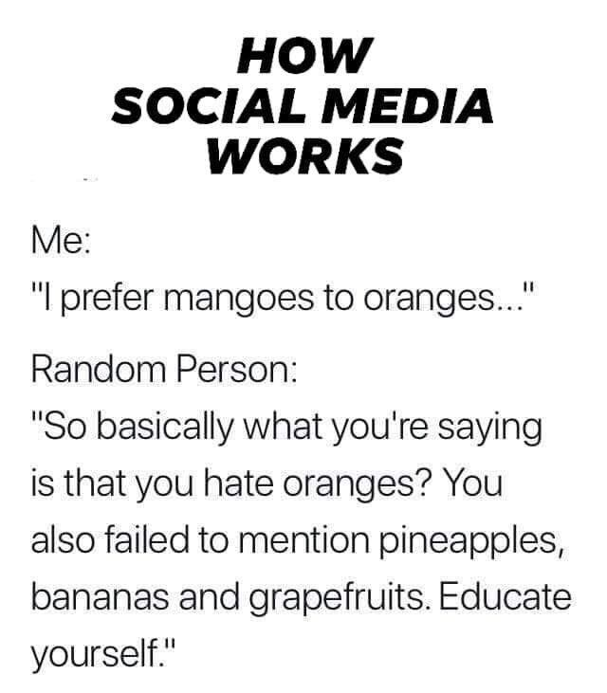
Respond to comments
Being engaged is great for your page.
If someone asks a question you want to answer them as promptly as possible.
If the comment isn’t something that needs a response – like it or heart it.
Your followers want to feel the relationship.
Also know the rules for your entity. i.e. a government entity CANNOT delete posts or comments.

Slide 31
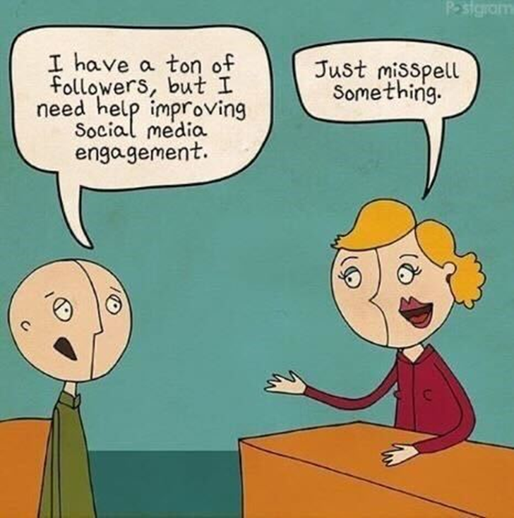
Grammar, spelling & NO ALL CAPS
Using all capital letters makes people feel like they’re being YELLED AT.
You don’t want to yell at a potential or consistent customer. Do you?
SPELL CHECK (yes we’re yelling), because if someone messes up a post on social media who knows what else they will mess up.
Main point… don’t make yourself or your business look dumb.
THIS IS YOUR BRAND.
PRESENTATION IS EVERYTHING.

Slide 32
Tag/Mention as many other places that can help you get exposure but don’t be annoying.
Let others share YOUR post – not vice versa. When you tag others and they share your post, it increases your impressions.
Increased impressions is what brings new followers, more engagement, etc.

Slide 33
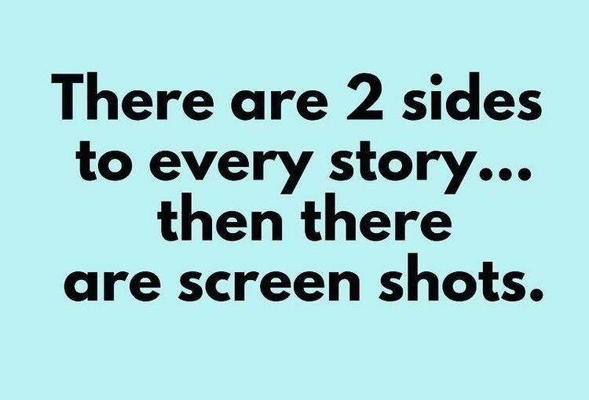
Crisis Communication
What you post is online forever, even if you delete it someone has probably already taken a screenshot.

Slide 34
What is Crisis Communication?
Crisis communication refers to the process of managing and sharing information during an emergency or unexpected event that could harm an organization’s reputation, operations, or stakeholders.
A clear plan ensures you:
Respond quickly and confidently.
Provide accurate information before rumors spread.
Demonstrate transparency, empathy, and responsibility.
Crises unfold fast — there’s no time to decide who should speak or what to say.
A plan:
Defines who communicates (spokesperson, PR team, leadership).
Establishes channels (press releases, social media, internal emails, etc.).
Provides templates and pre-approved messaging for different scenarios.

Slide 35
Purpose
The main goal of crisis communication is to:
Inform the public, employees, and other stakeholders quickly and accurately.
Protect the organization’s reputation.
Minimize confusion and panic.
Show accountability and maintain trust.

Slide 36
Key Elements
Preparedness: Having messages and protocols ready before a crisis happens.
Designated Spokesperson: A trained person who speaks on behalf of the organization.
Clear Messaging: Honest, concise, and compassionate communication.
Consistent Updates: Regularly providing accurate information as the situation evolves.
Monitoring: Tracking media and public responses to adjust messaging as needed.

Slide 37
Example
A public statement explaining what happened.
Steps being taken to fix the issue.
Contact information for affected customers.
Regular updates until the issue is resolved.

Slide 38
Ideas for you specifically
MidCoast
Hinesville Day Spa
CASA
Define audience segments & goals
Create a content calendar
Boost community engagement
Use conversion‐oriented posts
Improve reach through visuals & ads
Brand & consistency refinement
Leverage partnerships and local story‐telling
Business page no posts since Sept 2024-Wellness Center
HDS other page:
  Profile isn’t claimed
  Very you heavy
  Graphics aren’t always the best-Visual composition & consistency
  Caption clarity and calls to action
  Engagement prompts missing
  Consistency in posting rhythm
Friend page?
Business/fan other page:
  Engagement and social interaction
  Call to action and conversion focus
  Visual consistency & brand cohesion
  Storytelling and personalization
  Content variety

Slide 39
LCDA
Caption Engagement and Voice
Visual Consistency for LCDA-Branded Posts
Storytelling Opportunities (reshares)
Highlighting Local Impact
Engagement Metrics

